Slide 1
SVM – Part 2
Rakib Mahmud

Slide 2
SVM
Classification
Regression

Slide 3
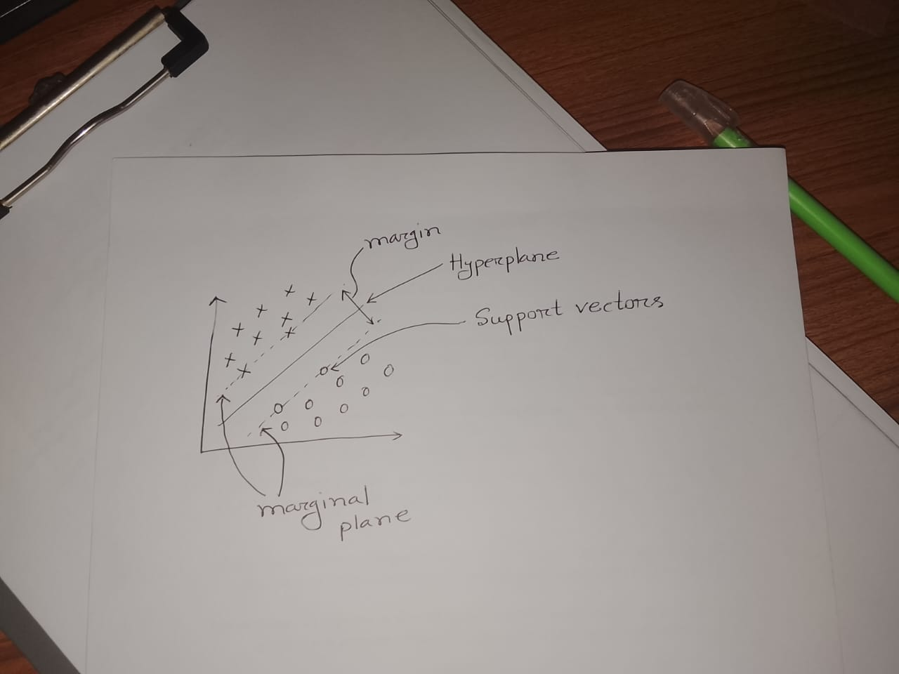
Hard Margin SVM
It is used for linearly separable data — that is, when the two classes can be completely separated by a straight line (in 2D) or a hyperplane (in higher dimensions) without any misclassification.

Slide 4
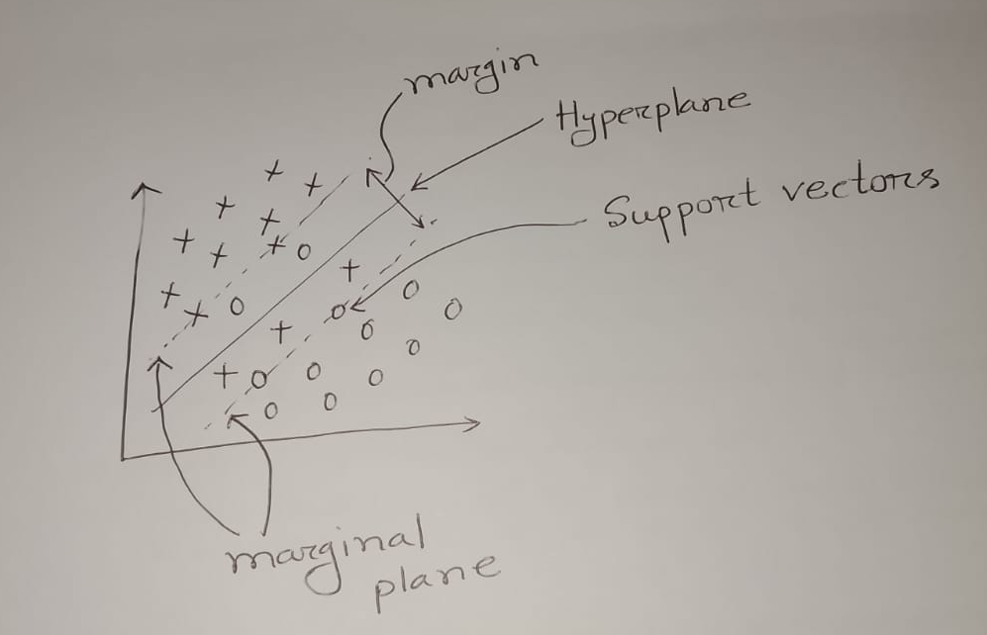
Soft Margin SVM
It is an extension of the Hard Margin SVM that allows some misclassifications.
It is common in real-world scenarios.

Slide 5
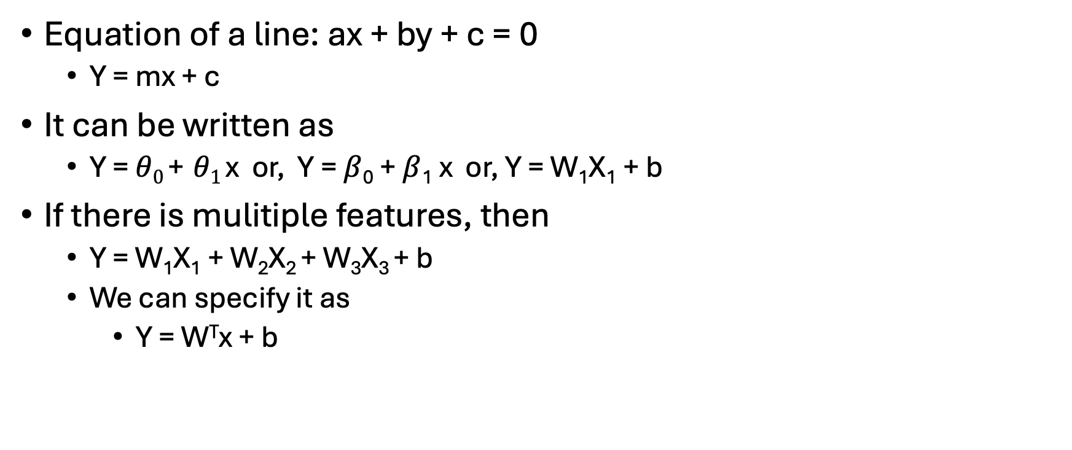
Equation of a line: ax + by + c = 0
  Y = mx + c
It can be written as
  Y = $θ0$ + $θ1$ x or, Y = $β$₀ + $β$₁ x or, Y = W₁X₁ + b
If there is mulitiple features, then
  Y = W₁X₁ + W₂X₂ + W₃X₃ + b
  We can specify it as
    Y = W^{T}x + b

Slide 6
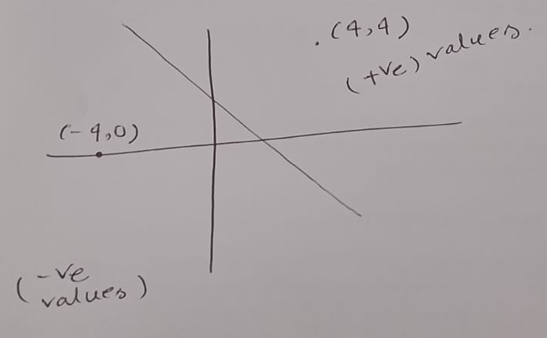

Slide 7
Let’s assume the equation of the hyperplane is 3x + 2y + 4 = 0
At (4, 4) we get 24, which is positive value
At (-4, 0) we get -8, which is negative value.
According to this, all the points above the hyperplane will yield a positive value, while all the points below the hyperplane will yield a negative value.

Slide 8
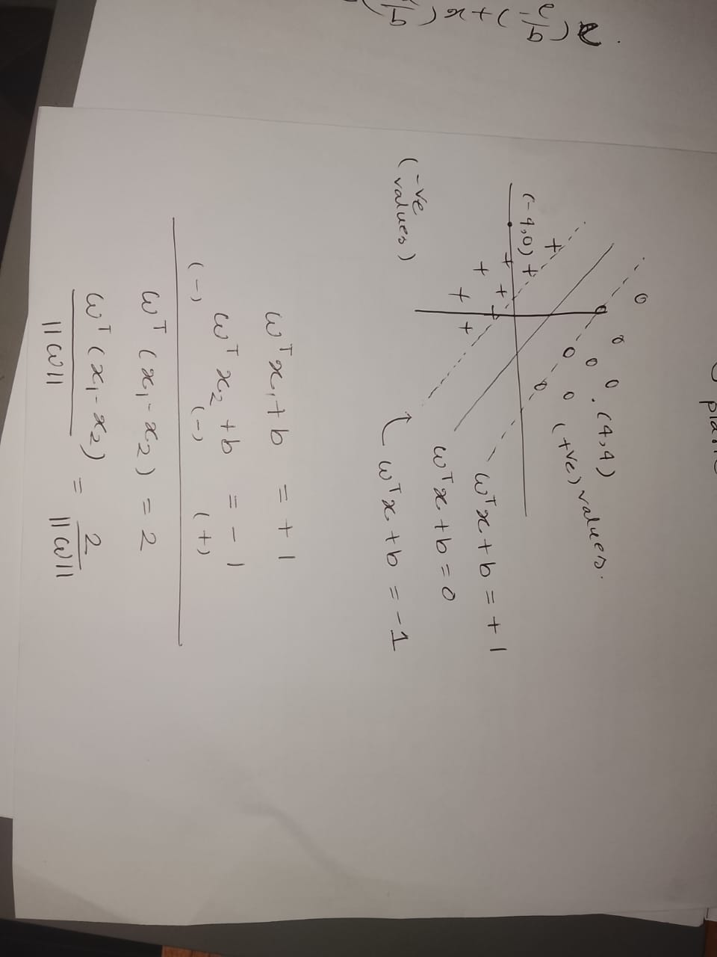
Notes:
আমরা $∥w∥$দিয়ে ভাগ করি কারণ $w^{T}x+b$কেবল দিক অনুযায়ী দূরত্ব দেখায়, আসল (লম্ব) দূরত্ব পেতে $w$-এর দৈর্ঘ্য দিয়ে ভাগ করে তাকে স্বাভাবিক বা প্রকৃত দূরত্বে রূপান্তর করা হয়।

Slide 9
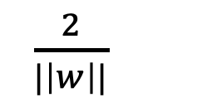

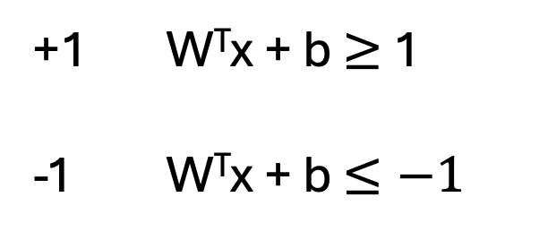
We need to add some constraints here
Such that
So, for all accurate datapoints y * (W^{T}x + b) $≥$ 1
Maximize
W,b
$\frac{2}{|\left|w\right||}$
= Marginal plane distance
+1 W^{T}x + b $≥$ 1
-1 W^{T}x + b $≤−1$
Y_{i}
Constraint

Slide 10
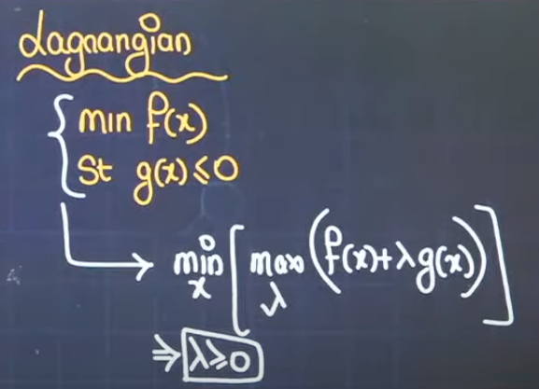
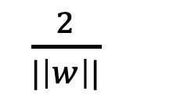
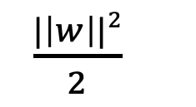
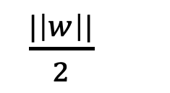
Maximize
W,b
Minimize
W,b
Minimize
W,b
$\frac{2}{|\left|w\right||}$
$\frac{|\left|w\right||}{2}$
$\frac{|\left|w\right||2}{2}$
y * (W^{T}x + b) $≥$ 1 (Constraint)
Lagrangian form
A single function combining the objective and constraints

Slide 11
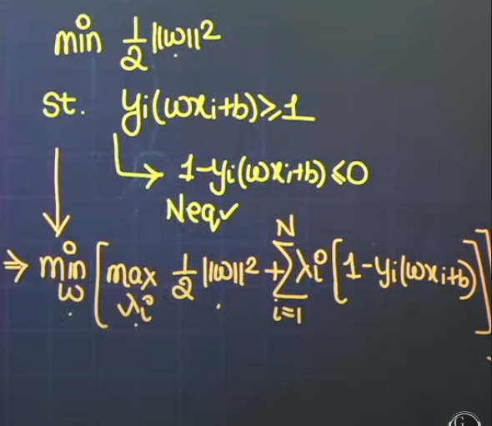
Notes:
The meaning is actually the same — the transpose symbol $T$is often omitted for simplicity in handwritten derivations or lectures, as long as it’s clear that $w$and $x_{i}$are vectors and their product $w^{T}x_{i}$means the dot product.

Slide 12
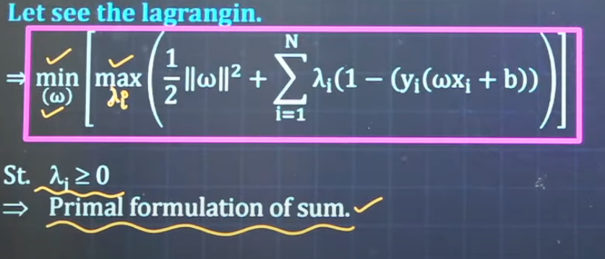

Expanded
Notes:
Primal = Original problem in terms of what you're directly looking for (w, b)
Dual = Transformed problem that's often easier to solve (λ)

Slide 13
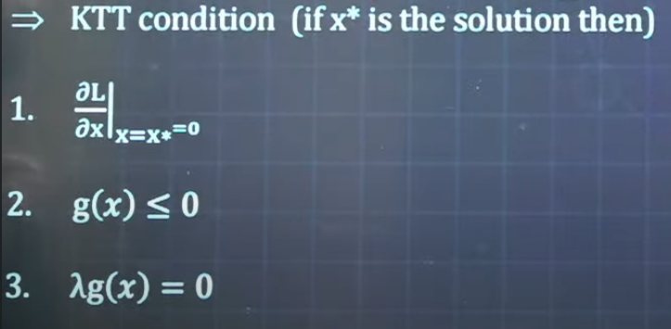

Slide 14

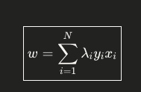

Slide 15

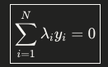

Slide 16
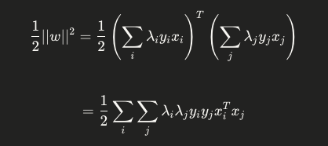
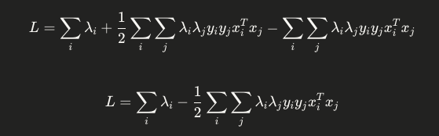

Slide 17
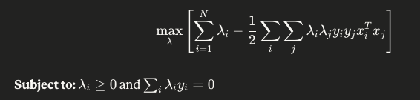
Finally Dual Form of SVM

Slide 18

Soft Margin SVM
Maximize
W,b
Minimize
W,b
Minimize
W,b
$\frac{2}{|\left|w\right||}$
$\frac{|\left|w\right||}{2}$
$\frac{|\left|w\right||2}{2}$
So, final cost function of SVM:
Constraint
hyperperameter
Notes:
একই minimizer কিন্তু ||w||² ব্যবহার করলে derivative সহজ এবং optimization faster।

Slide 19
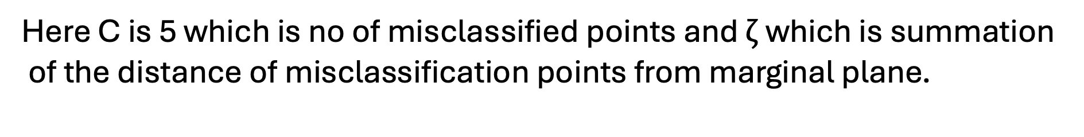
In real world, data is not linearly separable. There can be misclassified points.
Here for those misclassified points we won’t change our best fit line.
Let’s say, these amount of error is allowed.
Here C is 5 which is no of misclassified points and $ζ \text{which} \text{is} \text{summation} \text{of} \text{the} \text{distance} \text{of} \text{misclassification} \text{points} \text{from} \text{marginal} \text{plane}\text{.}$

Slide 20
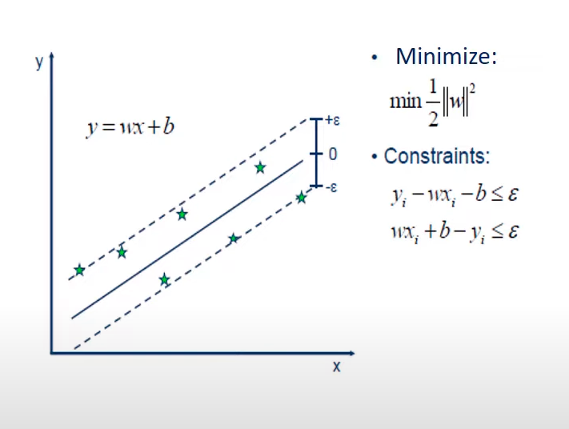
Support Vector Regressor
This is to find a hyperplane such that most of the training points are inside the marginal plane.

Slide 21
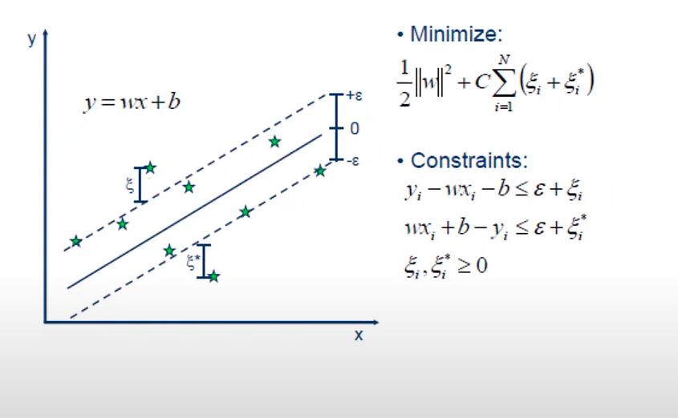
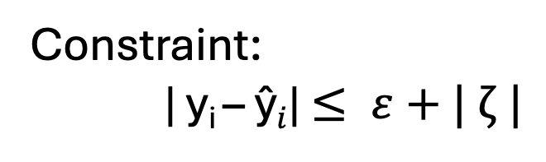
Cost Function:
Constraint:
Constraint:
| y_{i} – ŷ$i$| $≤ ε+| ζ |$

Slide 22
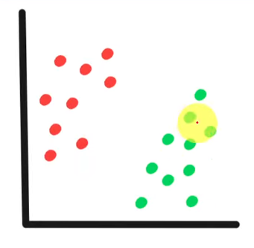
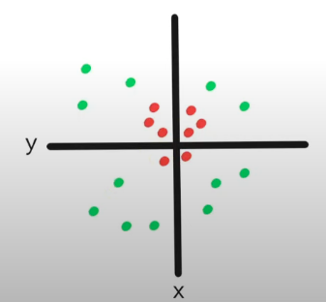
Types of SVM
There are two types of SVMs:
  Linear SVM: This type of SVM is used when input data is linearly separable, i.e, if a dataset can be classified into two classes by using a single straight line.
  Non-linear SVM: This type of SVM is used when input data is not linearly separable, i.e, if a dataset can’t be classified by using a single straight line.

Slide 23
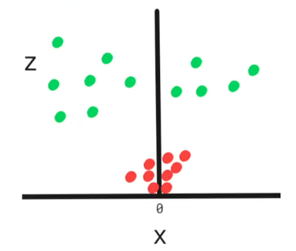
Kernel Trick in SVM
To separate Non-linear data points, we will take the help of kernels. Kernels will do the transformation.
If we observe 2d data is with the help of kernel in higher dimension, we will find this

Slide 24
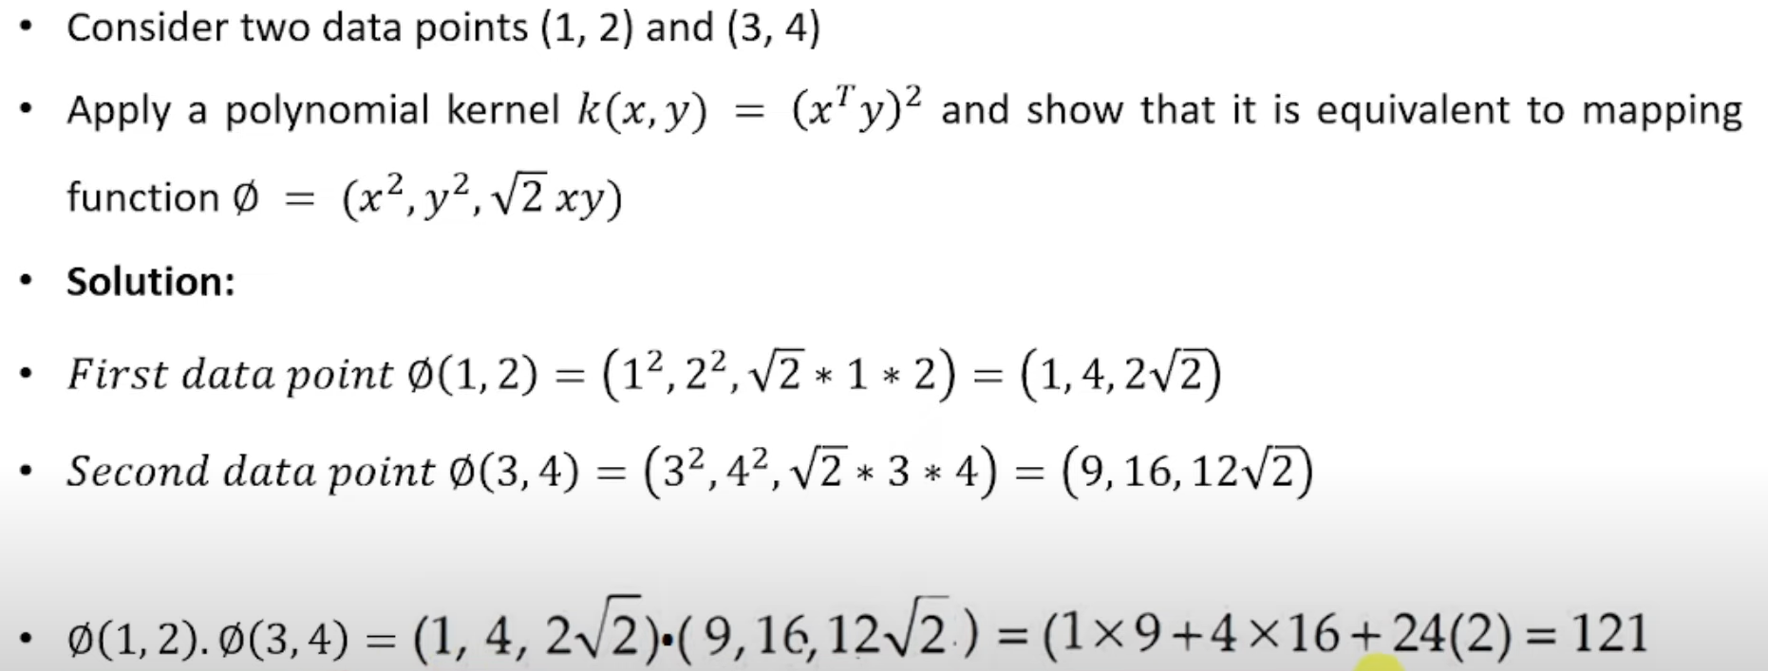

Slide 25
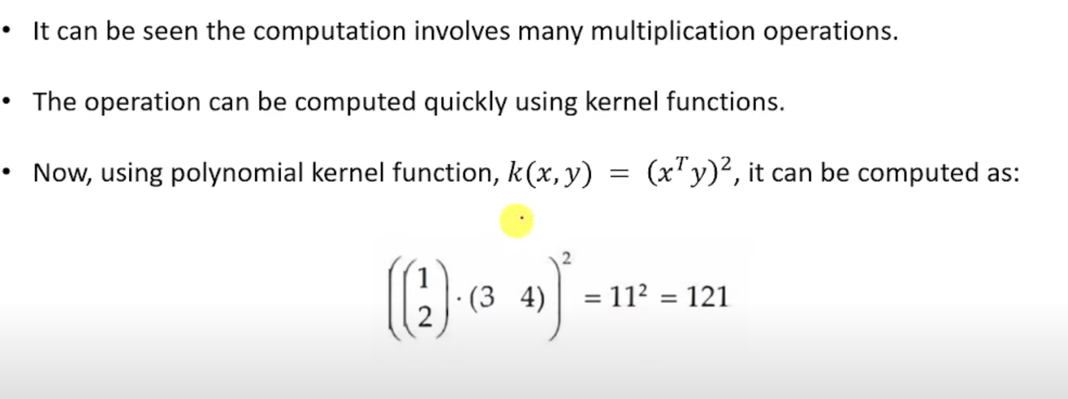

Slide 26


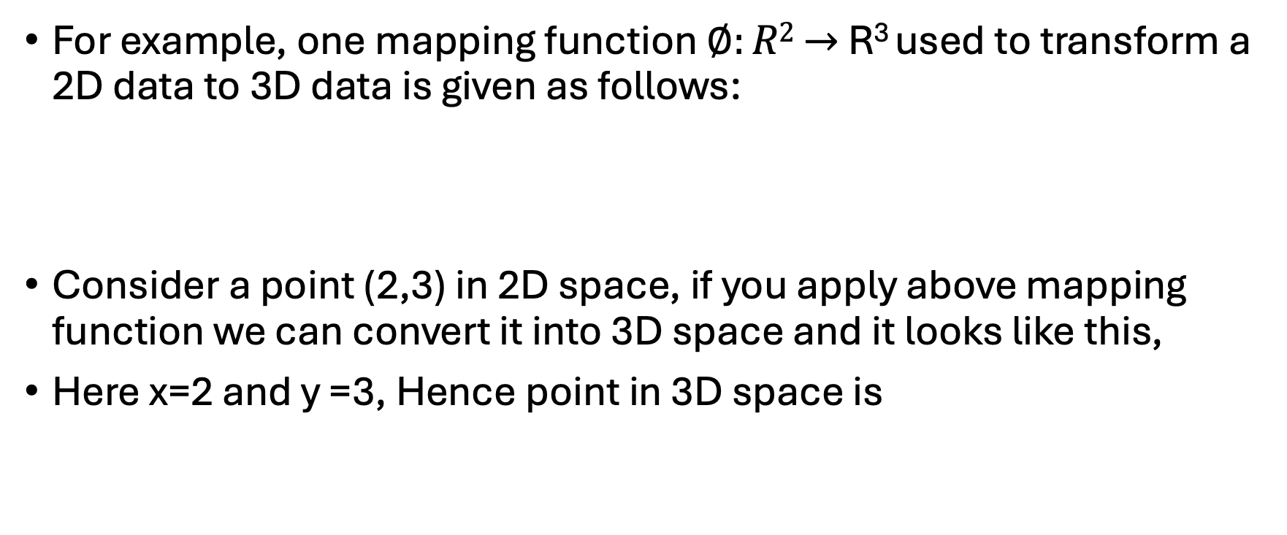
Kernel Trick in SVM
For example, one mapping function $∅:R2$ $→$ R³ used to transform a 2D data to 3D data is given as follows:
Consider a point (2,3) in 2D space, if you apply above mapping function we can convert it into 3D space and it looks like this,
Here x=2 and y =3, Hence point in 3D space is

Slide 27
Kernel Trick in SVM
While mapping functions play an important role, there are many disadvantages, as mapping involves more computations and learning costs.
Also, the disadvantages of transformation are that there is no generalized thumb rule available describing what transformation should be applied and if the data is large, mapping process takes huge amount of time.
In this context only kernels are useful.
Kernels are used to compute the value without transforming the data.

Slide 28
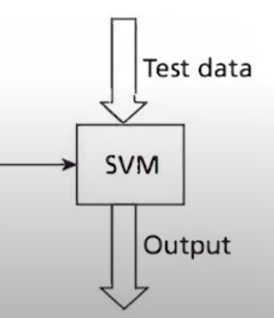
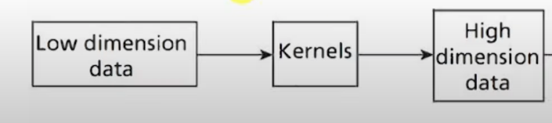
Kernel Trick in SVM
Kernels are a set of functions used to transform data from lower dimension to manipulate data using dot product at higher dimension.

Slide 29
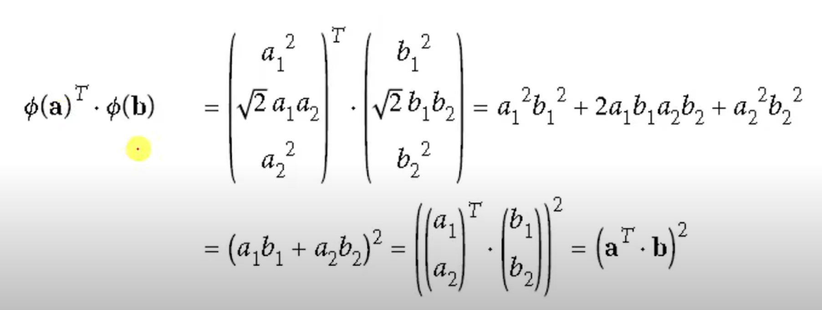
Kernel Trick for 2nd degree Polynomial Mapping

Slide 30
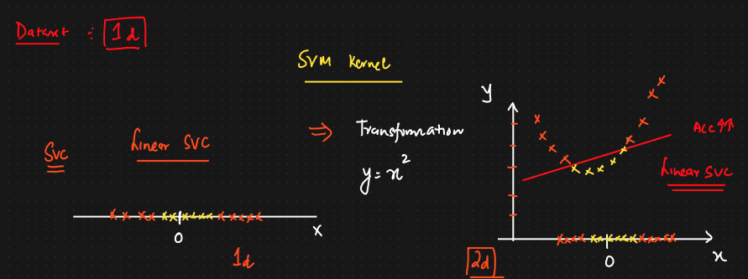

Slide 31
Types of Kernel
Linear kernel
Polynomial kernels
RBF kernels
Sigmoid kernels etc

Slide 32
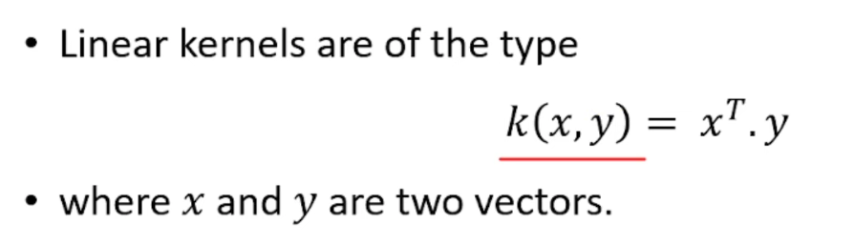
Linear Kernel

Slide 33
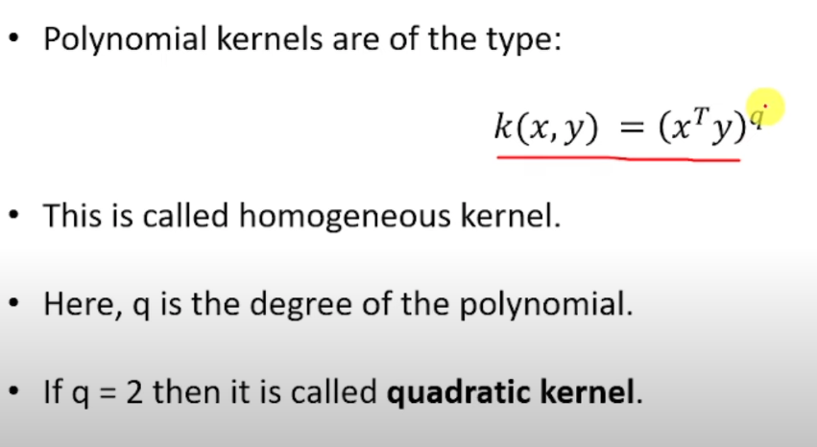
Polynomial Kernel

Slide 34
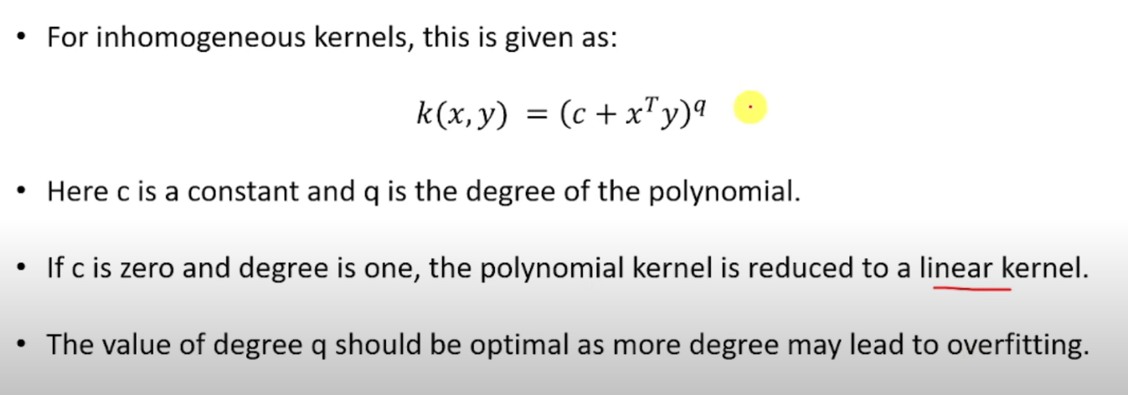
Polynomial Kernel (Cont’d)

Slide 35
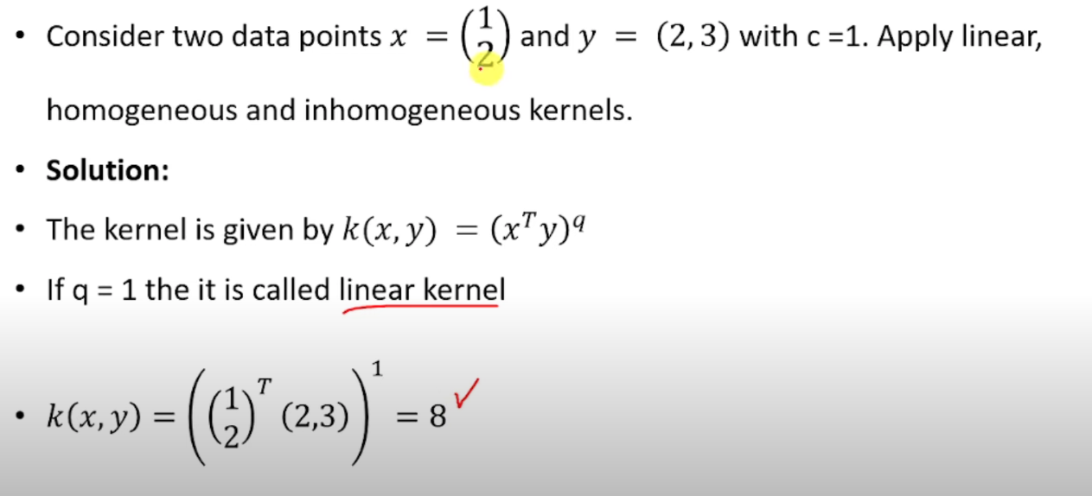

Slide 36
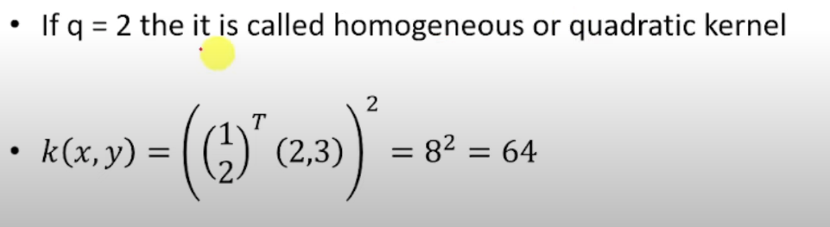
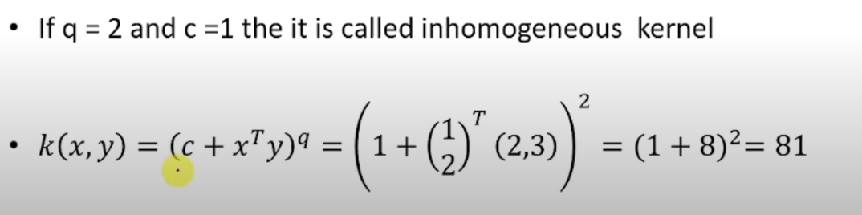

Slide 37
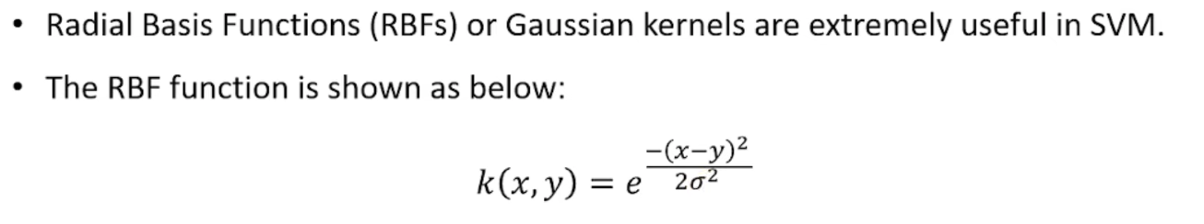
RBF Kernel

Slide 38
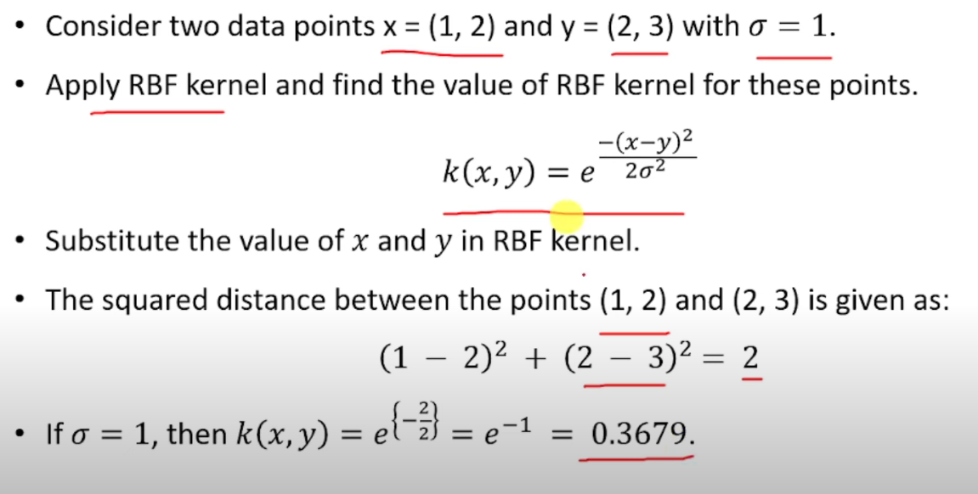
RBF Kernel (Cont’d)

Slide 39

Sigmoid kernel
The sigmoid (tanh) kernel is defined as:
where:
  α (alpha) = scaling parameter
  c = constant/bias term
  tanh = hyperbolic tangent function

